Slide 1


Environmental Flows: Training and implementation in developing countries
Environmental Flows for Ganga Basin Rejuvenation. Workshop, New Delhi, India
February 5-6, 2015
Jay O’Keeffe

Slide 2
CONTENTS
The quality, quantity and distribution of water required to maintain the
components, functions and processes
of aquatic ecosystems on which people depend.
Balancing resource use with protection
Environmental flows for rivers in different parts of the world
General lessons for countries developing policies for Environmental Flow assessment and implementation

Slide 3
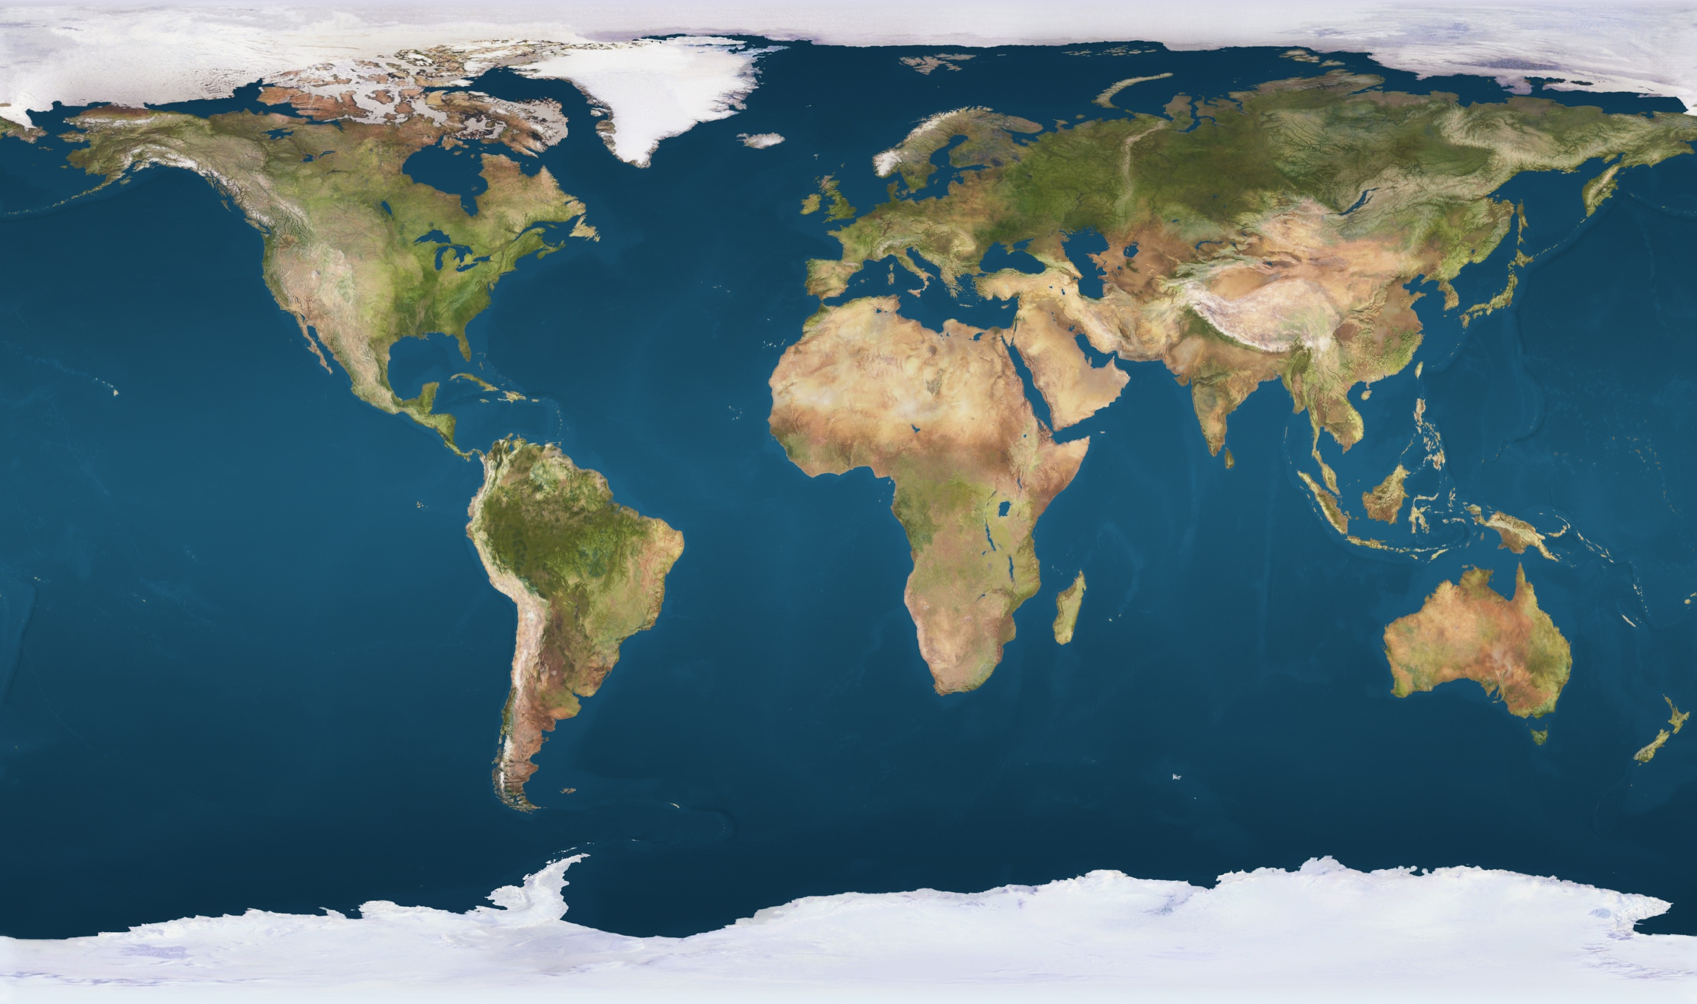
United
Kingdom
Delft
Orkhon R
Mongolia
Wisconsin
Neretva R
Bosnia
Lower Indus
Pakistan
Yellow &
Yangtze R
China
Konya Basin
Turkey
Rio Conchos
Mexico
Ghambiri, Ganga & Ramganga R India
Mara R, Kenya
& Tanzania
Ecuador
Wami/Ruvu
&
Lima
Peru
Sao Francisco R
Brazil
Rufiji R
Tanzania
Gt Ruaha
Tanzania
Zambezi Basin
South Africa
UNESCO-IHE/WWF/Rhodes Environmental Flows Training/Research projects 2005/14

Slide 4
In the past 20 years, environmental flows have become a standard part of developing water resource policy world-wide.
Le Quesne et al (2010) list policy and legislation developments which include a requirement for environmental flows in:
    Japan, China, Pakistan, India, countries of the Mekong basin, Australia, New Zealand, South Africa, Kenya, Tanzania, many US states, Mexico, Chile, Ecuador, Columbia, Costa Rica, Peurto Rica, Brazil, and EU countries.
They are "aware of no major nation in which environmental flows are not now being discussed and/or incorporated into high-level water policy decision-making".
Le Quesne T, Kendy E and Weston D (2010)
The implementation challenge: Taking stock of government policies to protect and restore environmental flows. Published by WWF and the Nature Conservancy. 67 Pages.

Slide 5
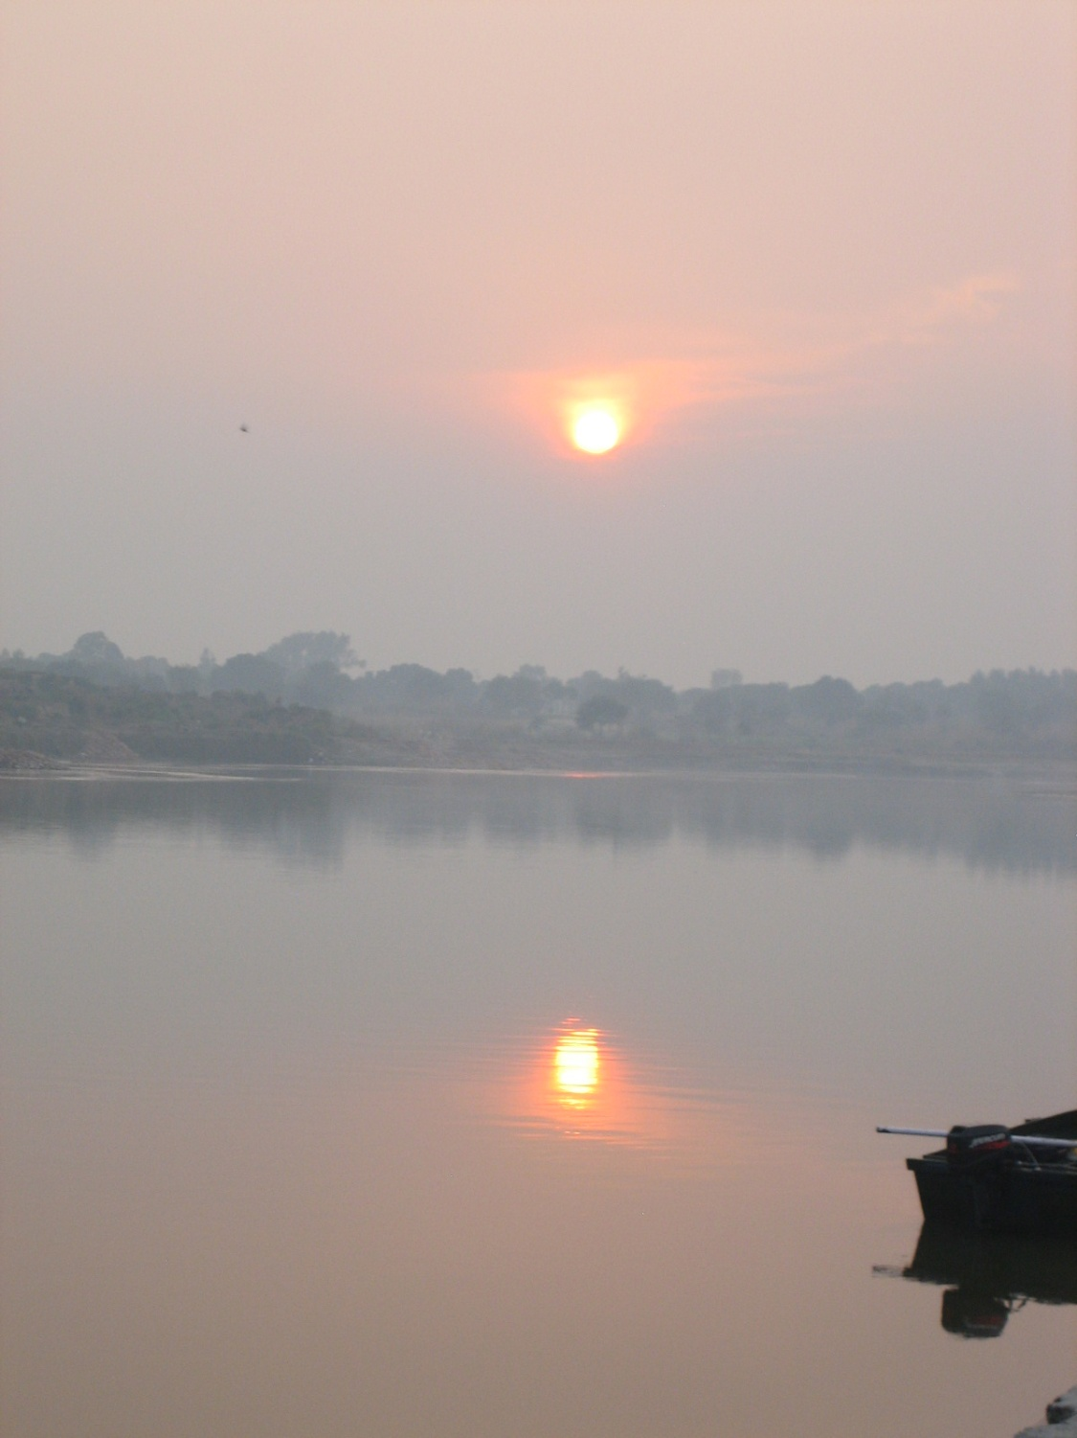
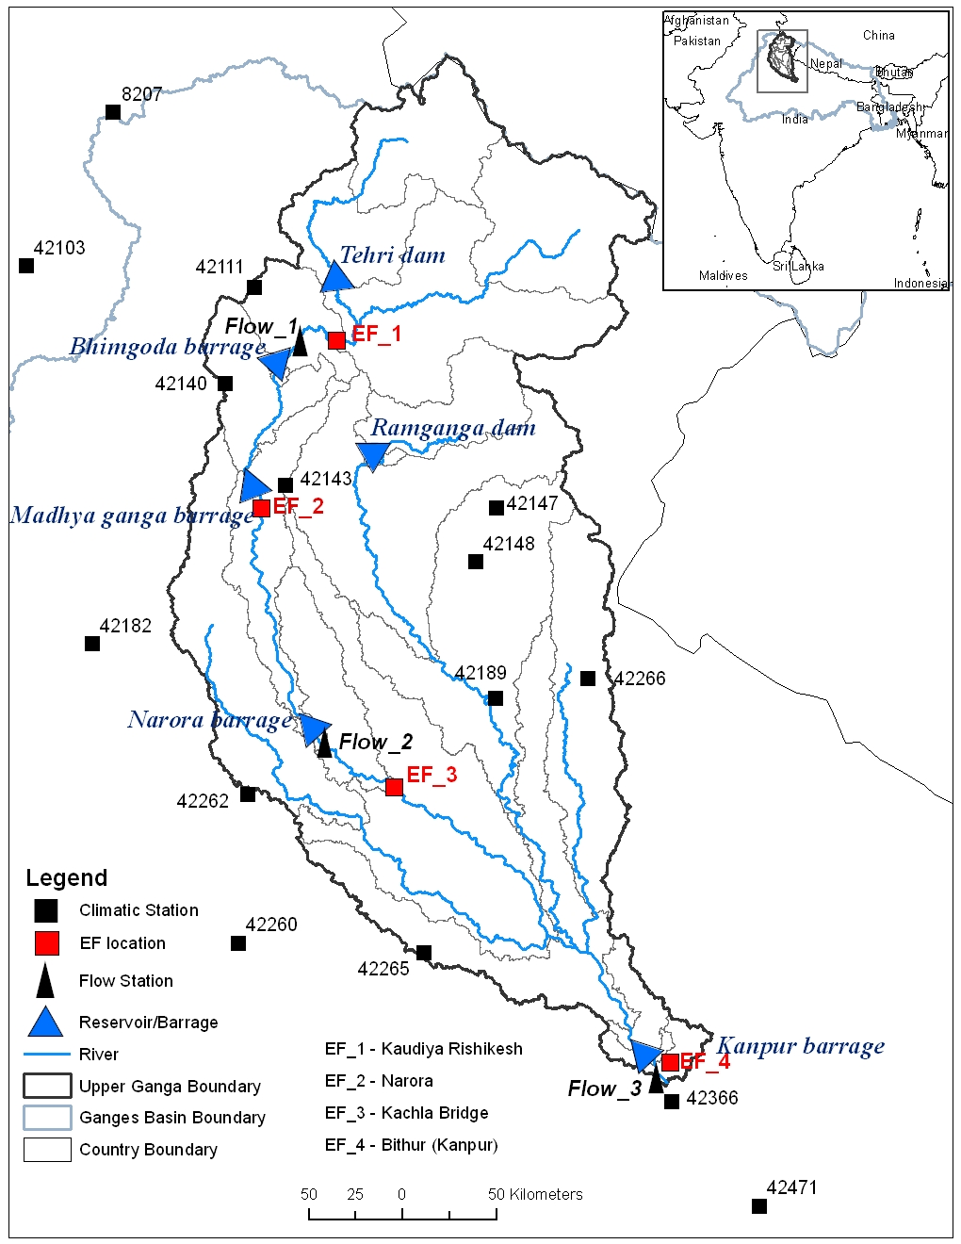
Upper/Middle
Ganga River
India
EF 3 Kachla Bridge

Slide 6
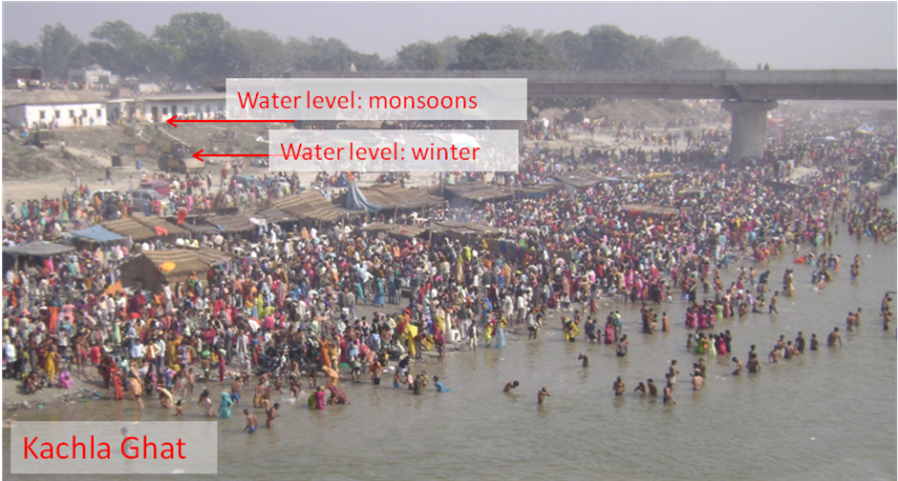
LOKGARIWAR C., CHOPRA R., SMAKHTIN V., BHARATI L. & O’KEEFFE J. (2013)
Including cultural water requirements in environmental flow assessment: an example from the upper Ganga River, India. Water International. Published online 7th December, 2013. DOI:10.1080/02508060.2013.863684.

Slide 7
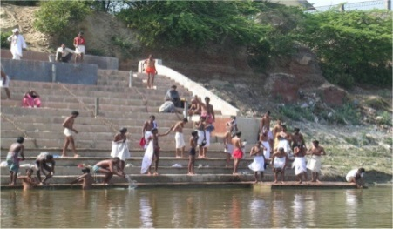
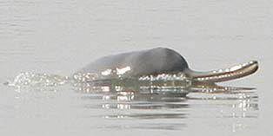
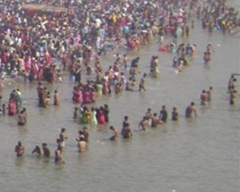
Flow Requirements at Kachla Ghat Cross section, Ganga River
Bather Requirements
Depth range dry season:
1.4 to 3.7m
Upstream of Narora
Present dry season depth

Slide 8

The Ganga River
India
Lesson: Social/cultural/spiritual issues are primary, but ecological
indicators can be strongly linked

Slide 9
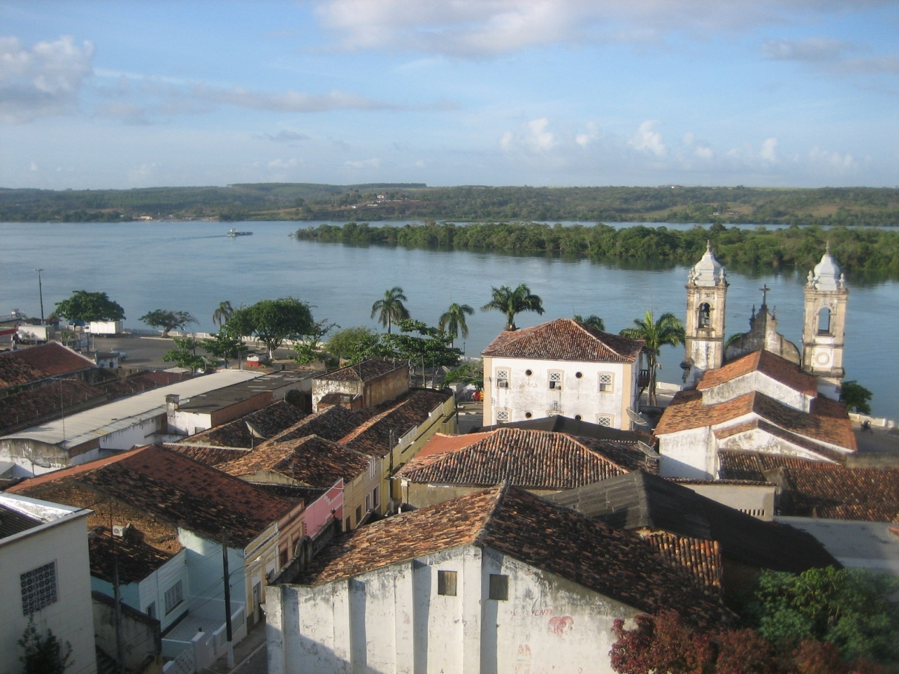
Sao Francisco River,
Brazil

Slide 10
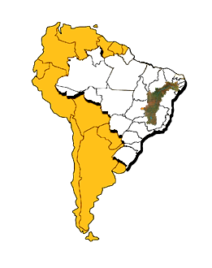
10 km

Slide 11
SOBRADINHO
34.116hm³
1050 MW
V = 60%SE
TRÊS MARIAS
19.523hm³
396 MW
V = 32%SE
CEMIG
APOLÔNIO SALES
400 MW
PAULO AFONSO
I - 180 MW
II - 443 MW
III - 794 MW
LUIZ GONZAGA
10.782hm³
1480 MW
V = 8%SE
PAULO AFONSO IV
2462 MW
Dams in the
Sao Francisco River
XINGÓ
3162 MW

Slide 12
Loss of flow variability in the
lower Sao Francisco river
1987

Slide 13

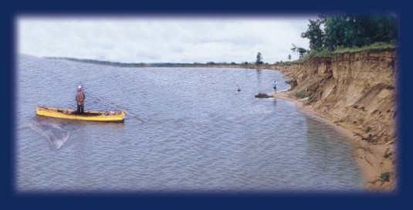
5 m

Slide 14
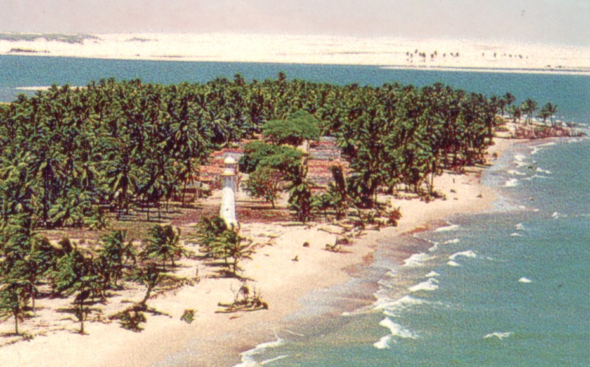
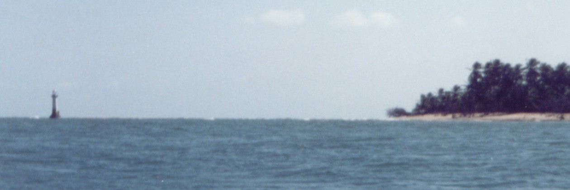

Slide 15
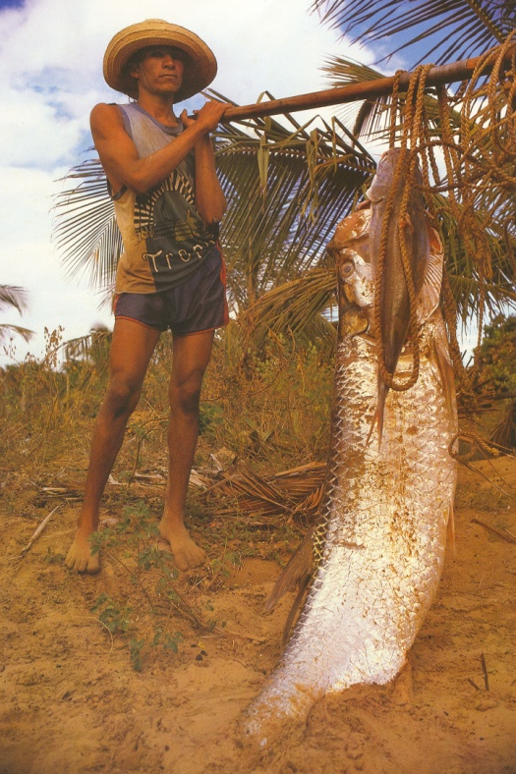
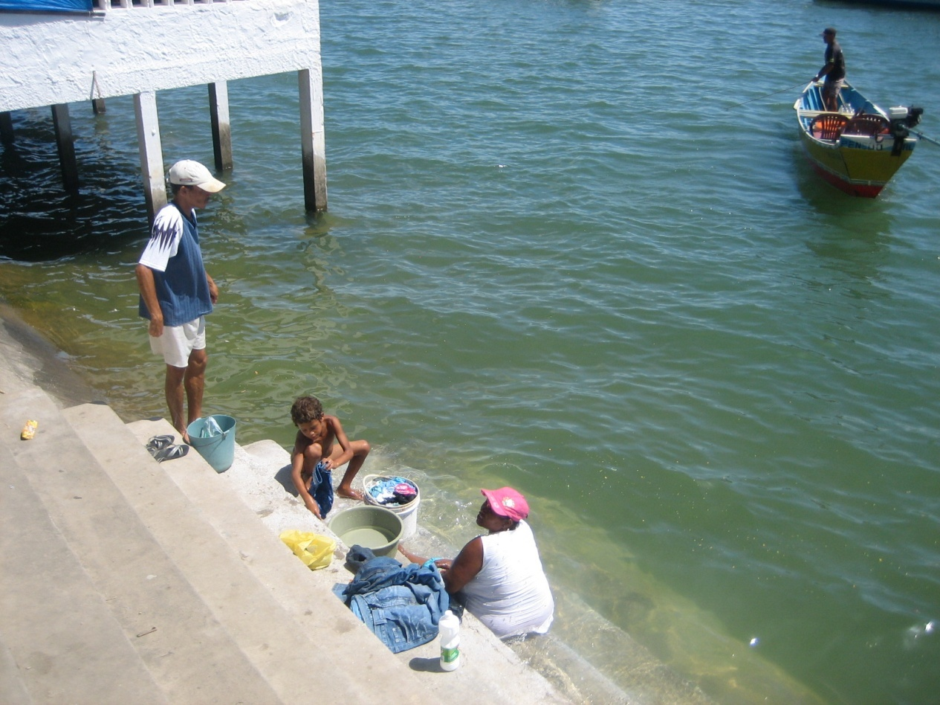
Lesson: Even very large rivers need environmental flows, but
the emphasis may be on macro-processes, rather than
on individual species or ecological indicators
Arapaima

Slide 16
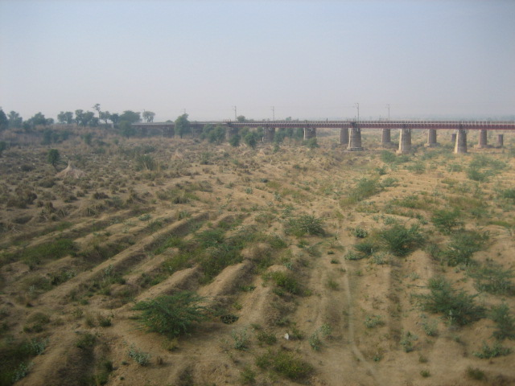
The Ghambiri River
India
Lesson: For the first training, choose a river where there is
a good chance of implementing e flows

Slide 17
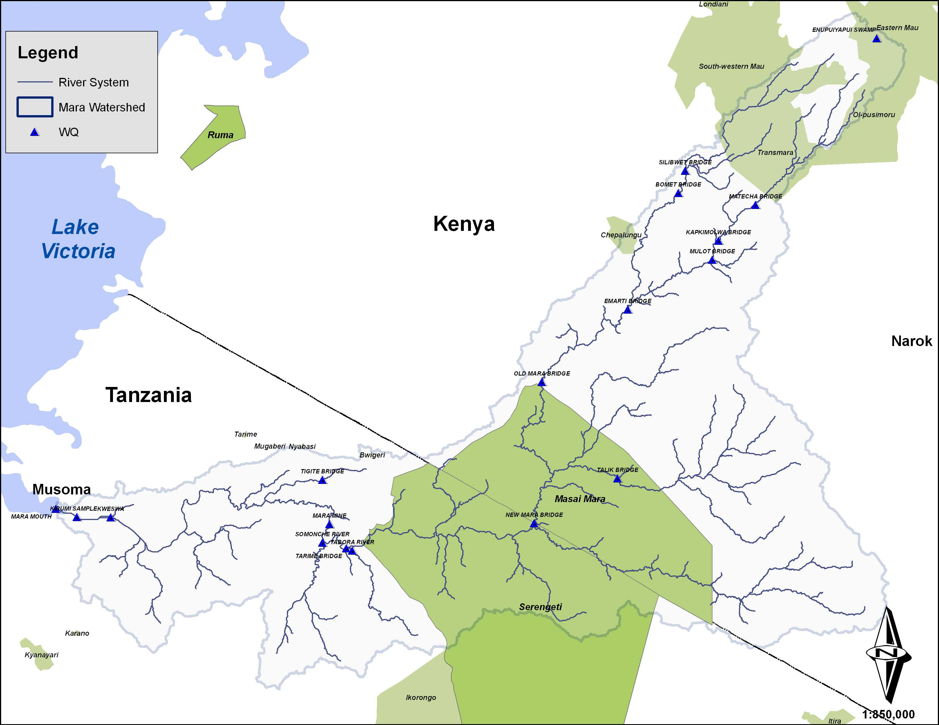
The Mara River,
Kenya & Tanzania
Lesson: When most of the flow is still unused,it’s worth
spending time and money on a high-confidence EFA,
for inclusion in future water allocation plans

Slide 18
Flow for a normal year: Site 3 Mara River, Tanzania Border
Present Day
45
Recommended (BF+ Floods)
40
Recommended Base Flow (BF)
35
Long-term average EFA:
50% of present flow
30
25
Lesson: Sometimes, an EFA can reassure stakeholders
that there is still plenty of water for all purposes
Ave. Monthly flow (cub. m/sec)
20
15
10
5
0
Jan
Feb
Mar
Apr
May
Jun
Jul
Aug
Sep
Oct
Nov
Dec
Month

Slide 19
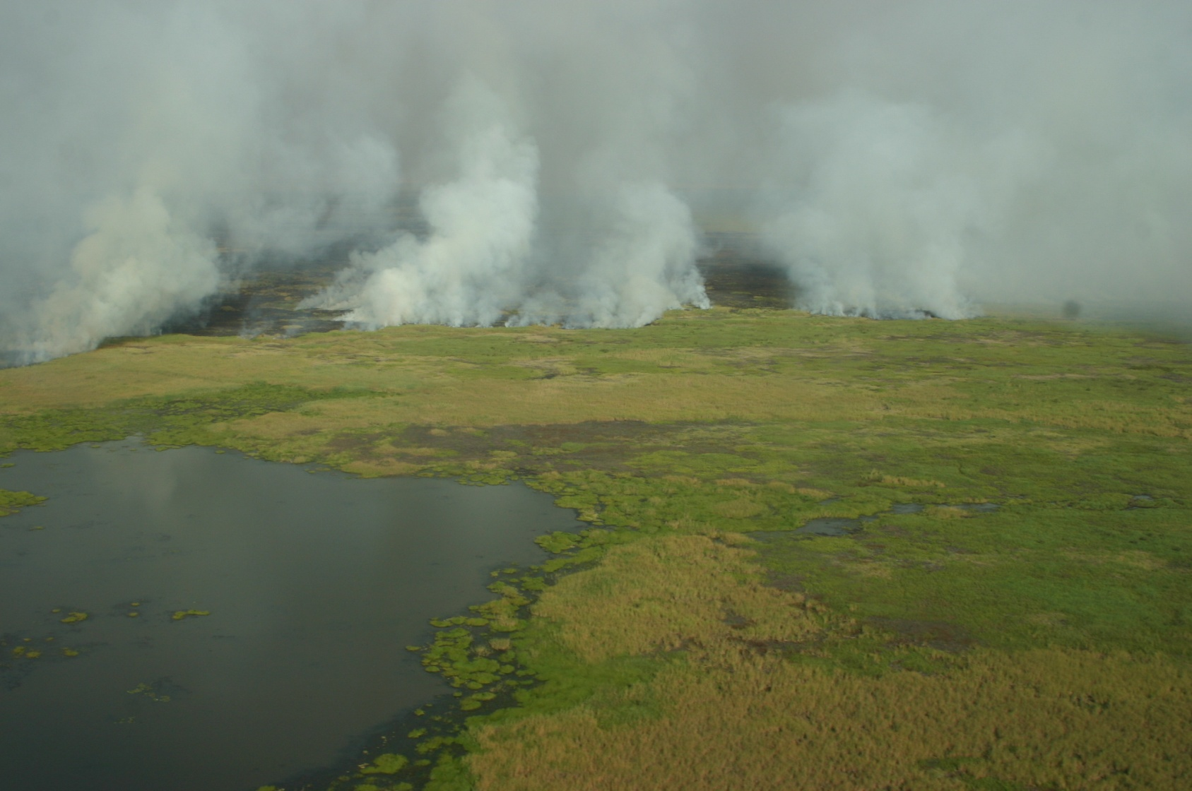
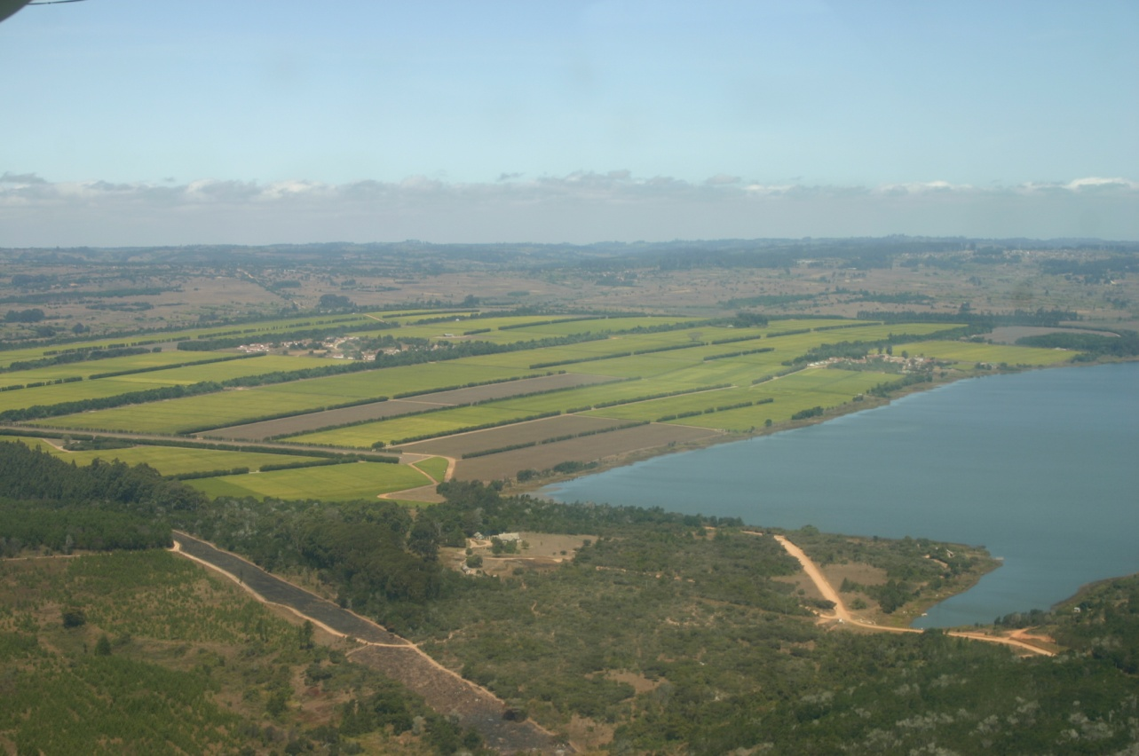
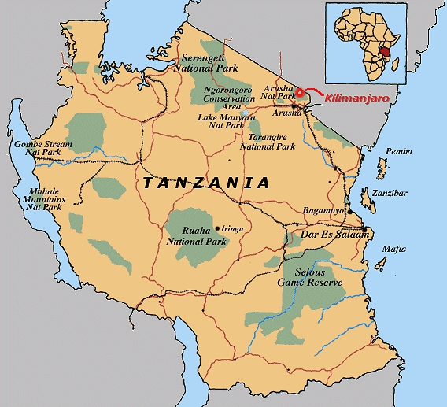
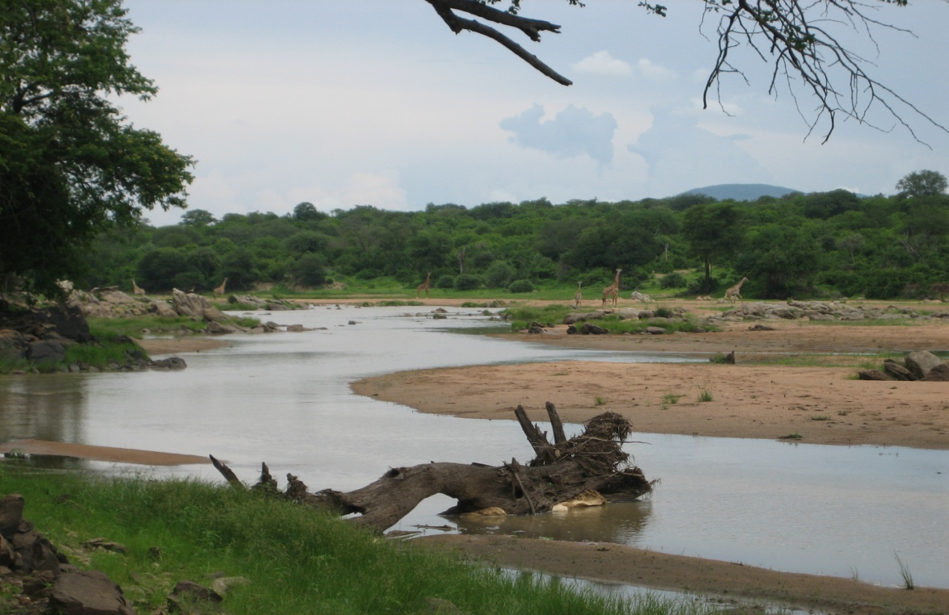
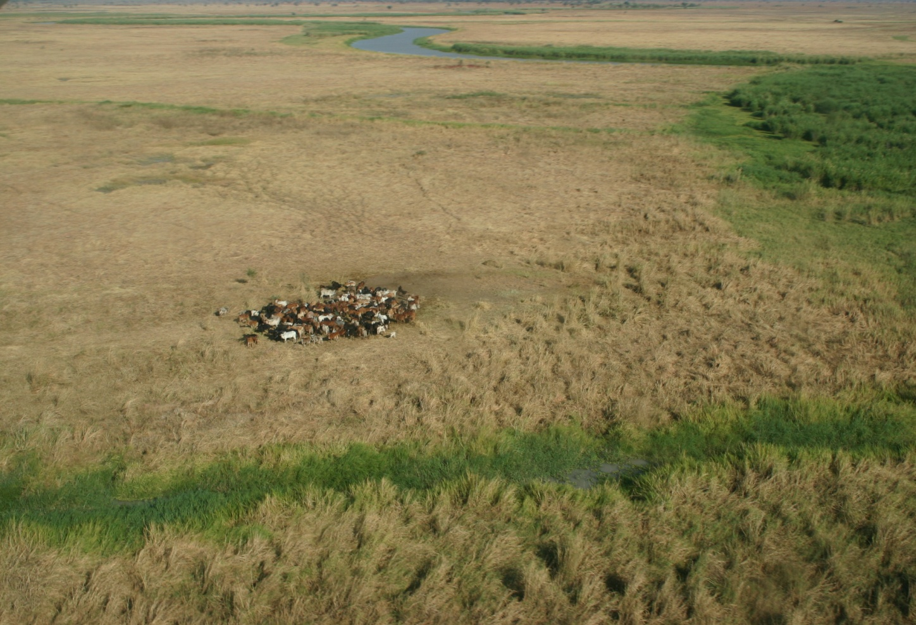
Gt Ruaha River & Usangu Wetlands,
Tanzania
No flows in the Ruaha National Park during the dry season since early 1990’s, due to irrigated rice, upland clearance, and wetland evapotranspiration

Slide 20
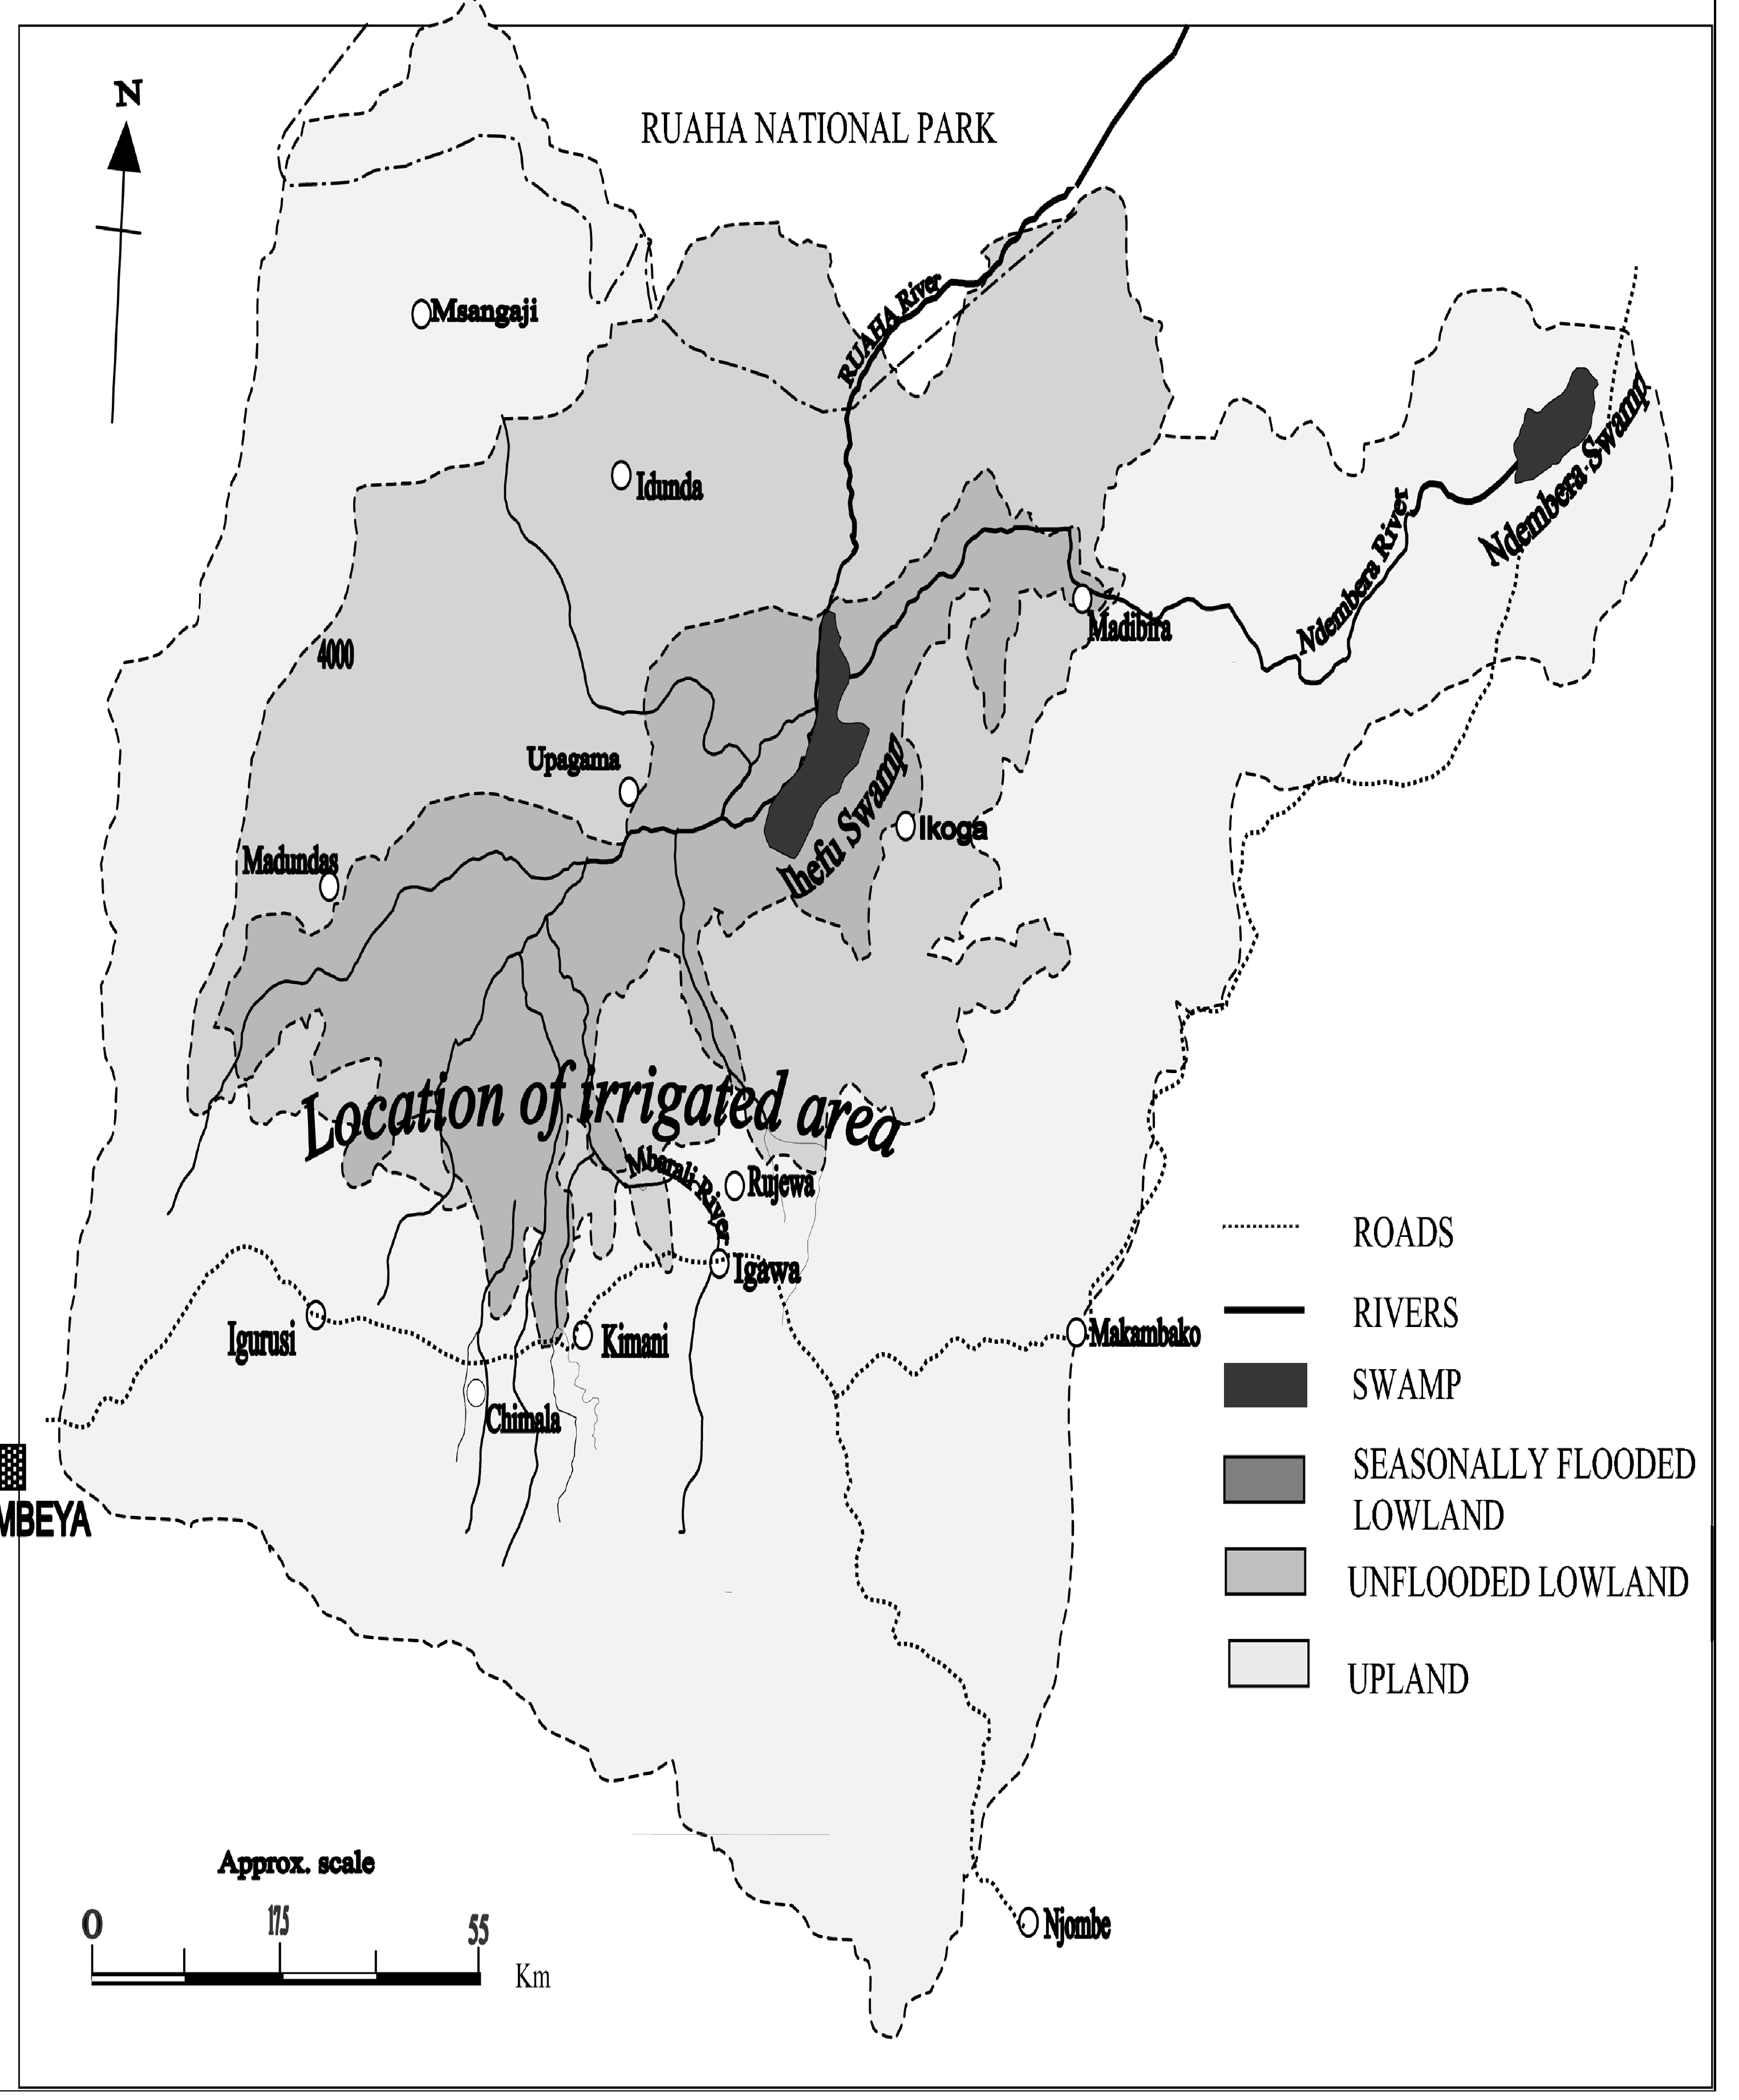
OPTIONS
Upland storage
Transfer from tributary
Efficient irrigation
Engineer the wetland
Lesson: When all the flow has been removed, concentrate on some
immediate flow restoration, and then monitor and refine

Slide 21
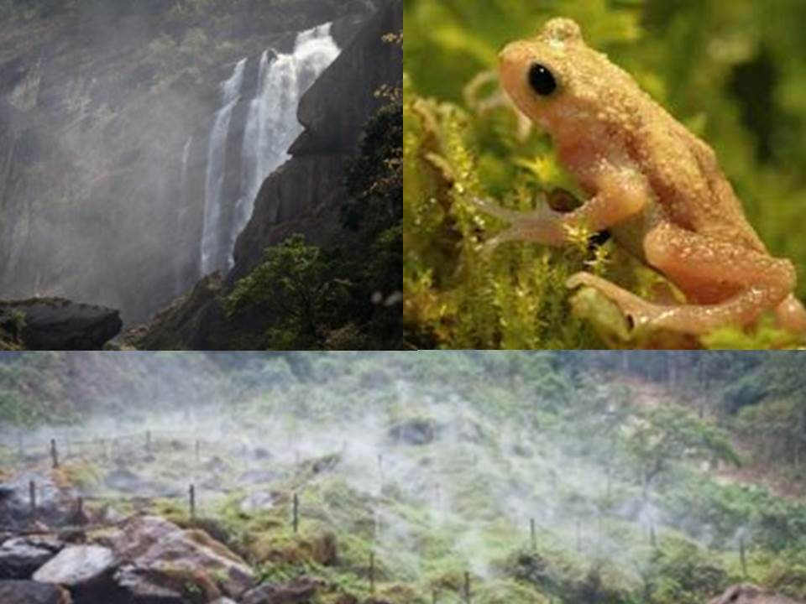
Lesson: Try to use locally relevant flow motivations which will
stand up to water conflict issues
Kihansi Gorge, Rufiji River Basin, Tanzania

Slide 22
Principles of Environmental Flow Assessment (EFA)
EFA’s are only predictions.
EFA methodologies are frameworks for organising available data and information.
Any EFA methodology can only provide accurate high confidence recommendations, if the available information is detailed and accurate.
Hydrological data, and hydraulic habitat data are critical to accurate and high-confidence flow recommendations
Rapid EFA methodologies provide flow recommendations and general motivations, but comprehensive EFA methodologies provide specific reasons for the recommended flows.

Slide 23
Nine principles of Environmental Flow Assessment (EFA) cont.
Any EFA team should only use a methodology with which one or more of the specialists has wide experience.
Assessing the consequences of different flows in rivers is a scientific process, but deciding on environmental objectives is a societal judgement.
An EFA and its implementation should be an adaptive process.
Stakeholder understanding and involvement in the EF process is essential for successful implementation.

Slide 24
Possible developments for E Flows in India
Centralised coordination of E Flows activities under a single authority
Training courses (one team per state?)
Development of E Flows policy/legislation
Development of a classification system for the environmental state of rivers
Consistent (but flexible) framework for EFA’s
Regional preliminary assessment of E Flows for all rivers (eg using IHA)
Centralised E Flows database and library
Communication and promotion programme for E Flows
Pilot E Flows implementation programme
National River Health Programme.

Slide 25
Finally
Recognise that it all takes time …….

Slide 26
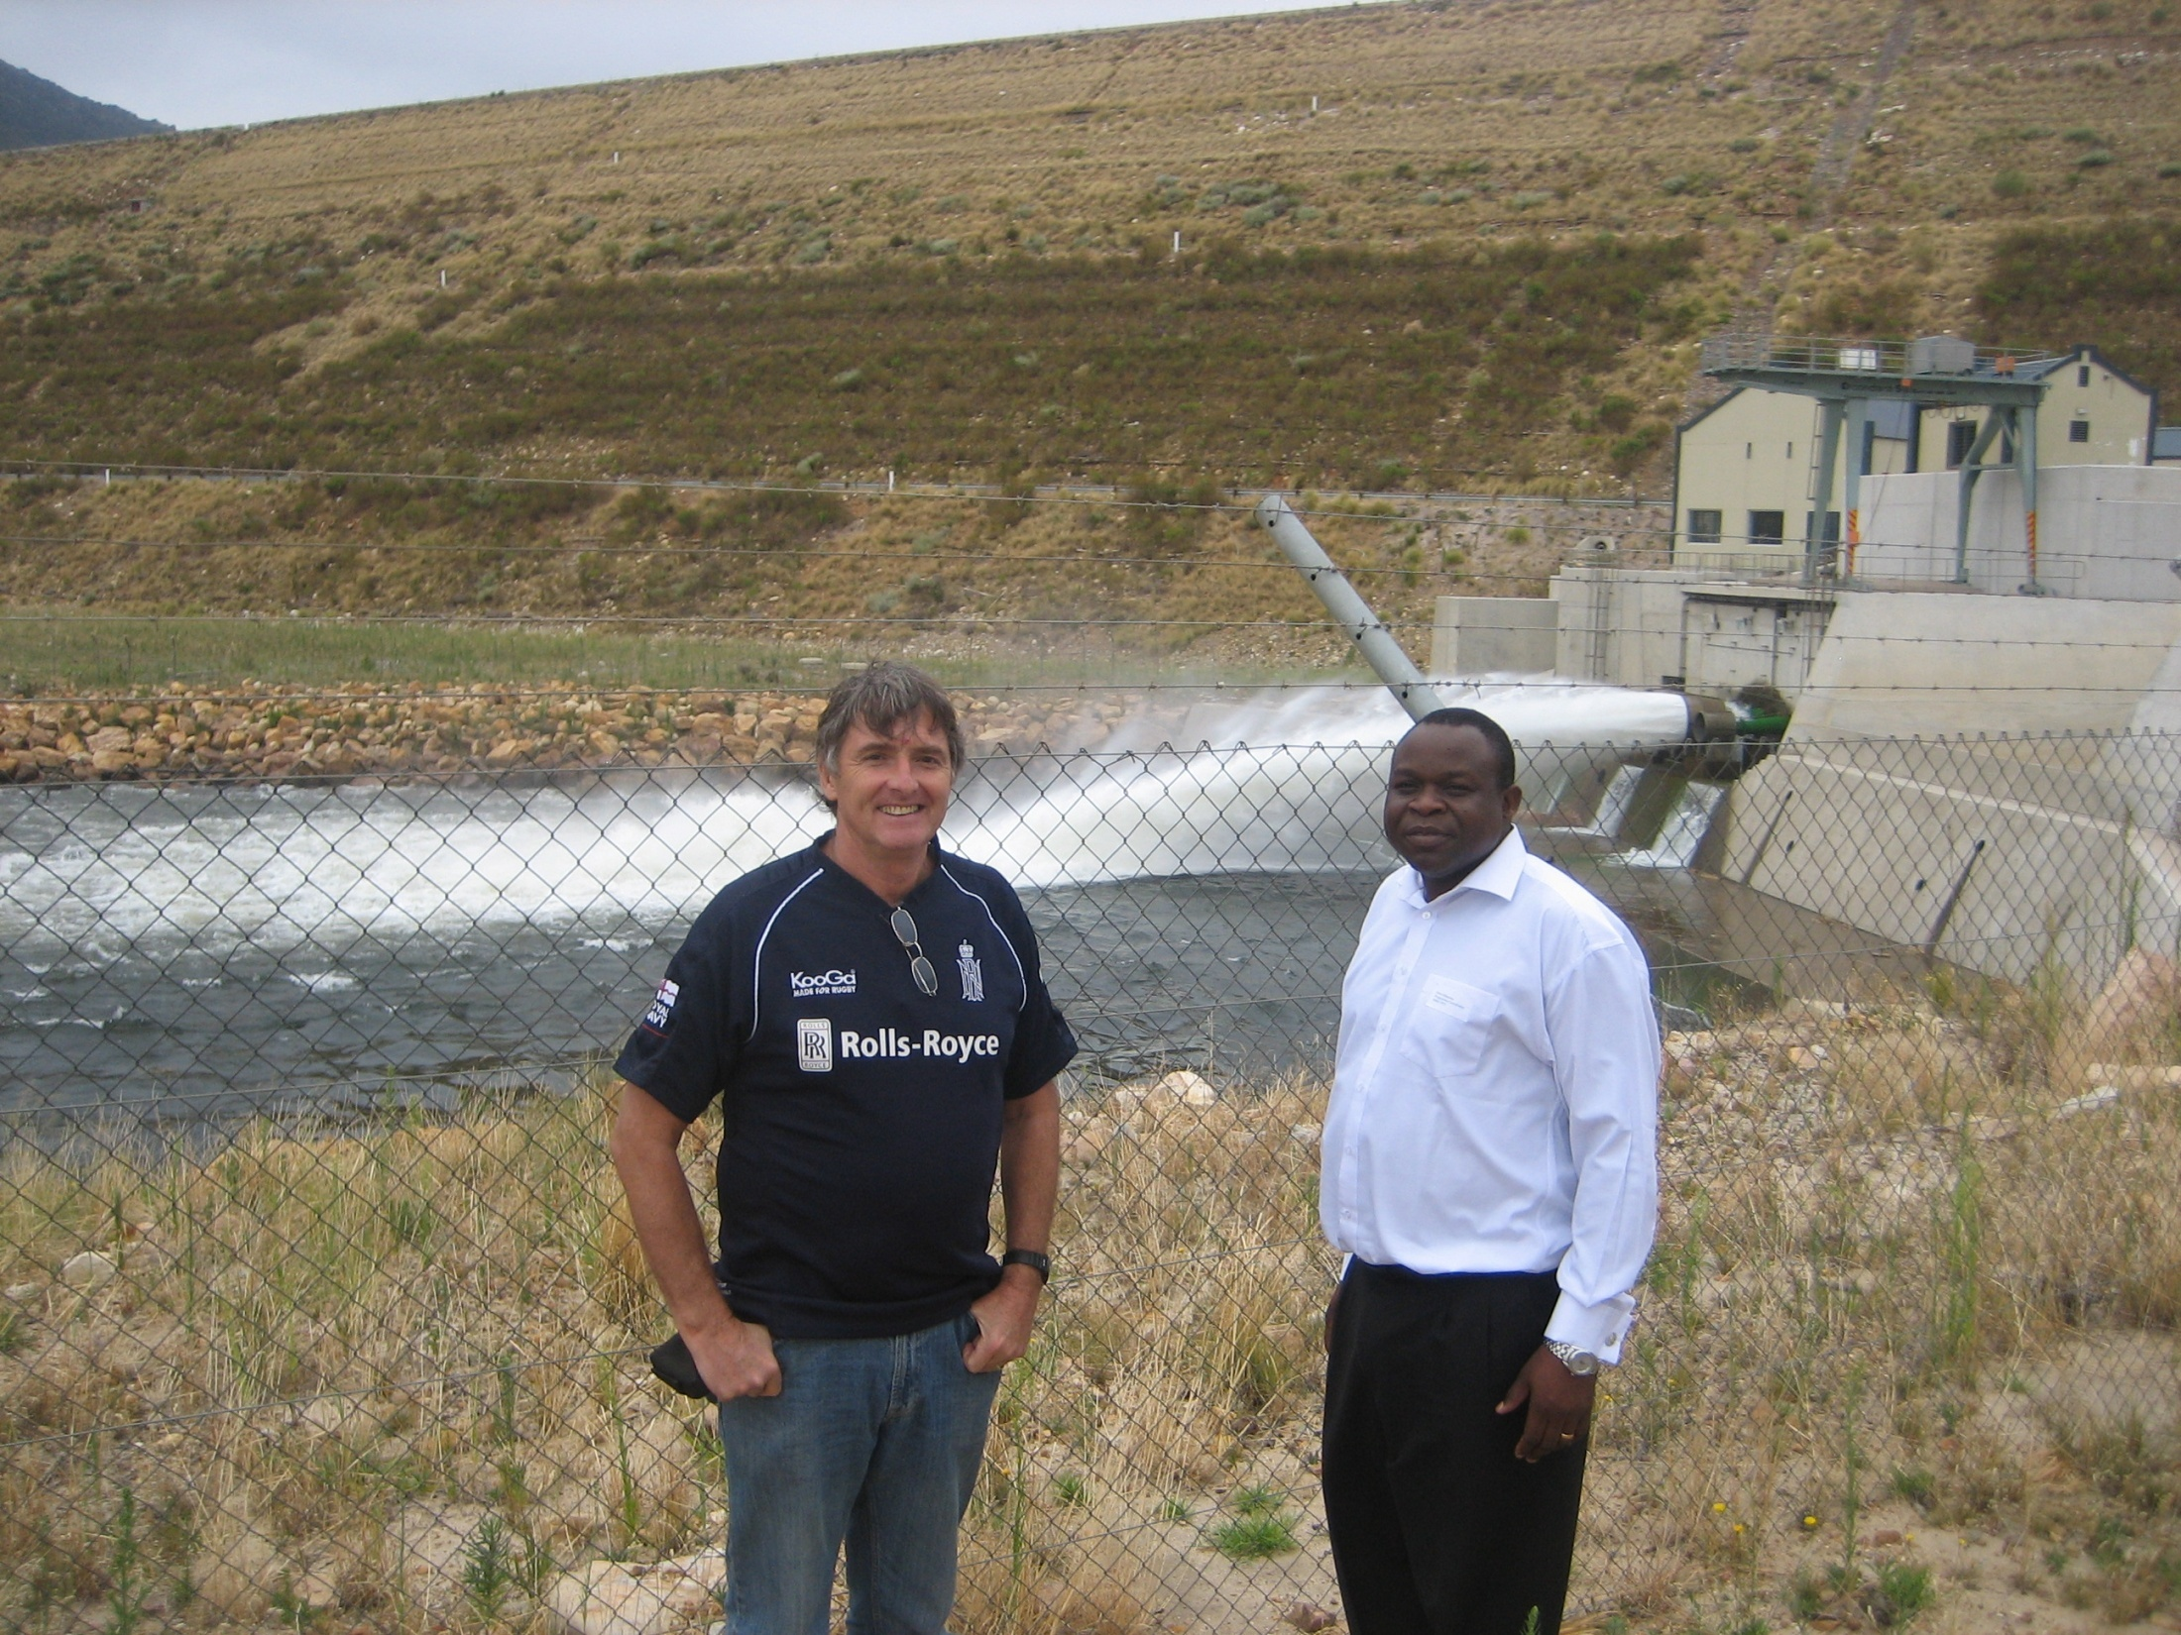
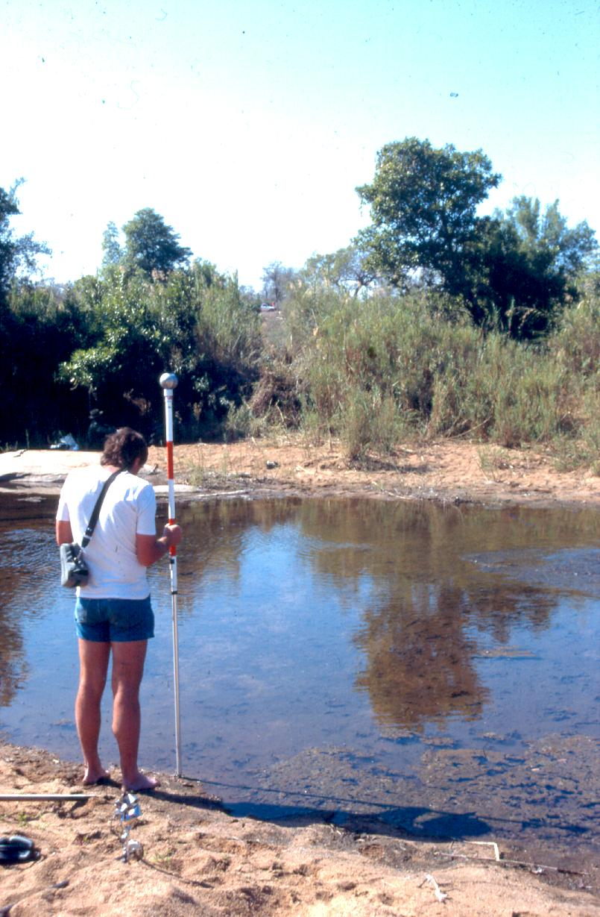
1998: New Water Act
1985: Surveying the
Sabie River to assess
environmental flow
2009: The new Berg River Dam releasing an environmental flow
Part 3: The Reserve
The basic human needs reserve
  provides for the essential needs of individuals.
The ecological reserve
  relates to the water required to protect the aquatic ecosystems of the water resource.

